Slide 1
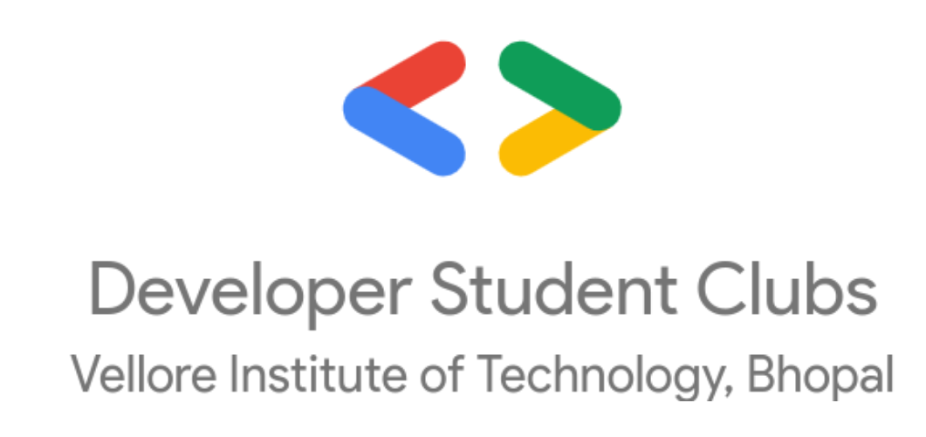
How to Get Started with ML

Slide 2
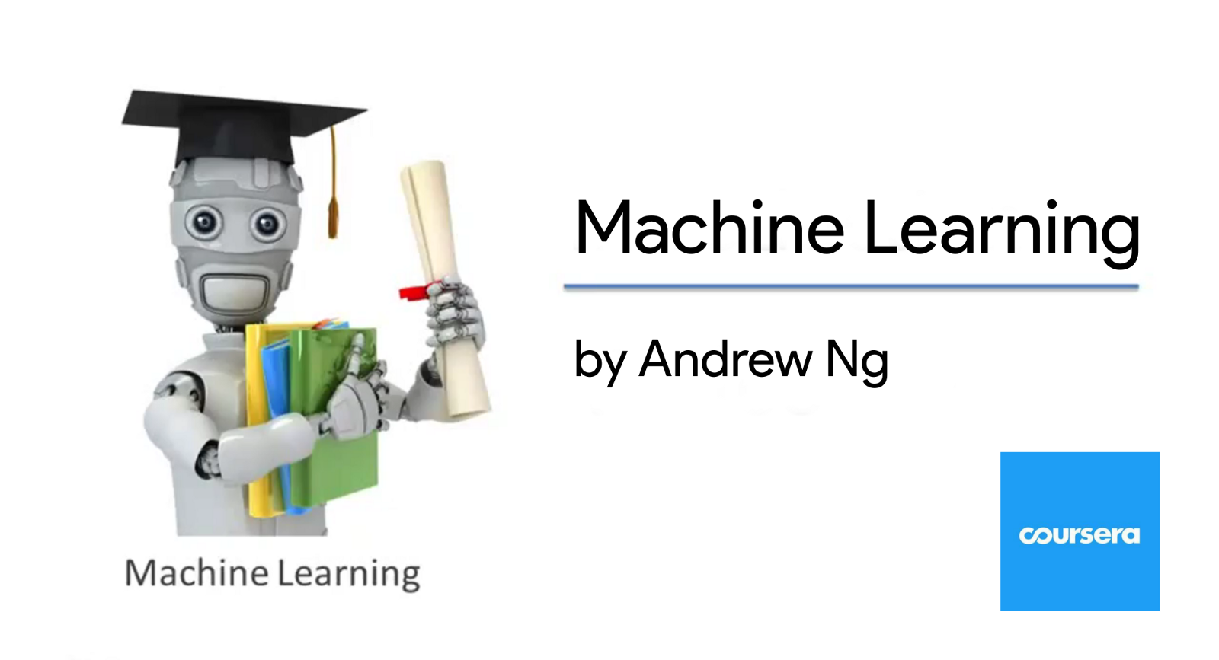
How to Get Started with ML
Learn ML Concepts
1.Learn the basics of Machine Learning Course Name-Machine Learning By Andrew Ng Platform-Coursera Topics Covered- Linear Regression Logistic Regression SVM Neural Network Unsupervised Learning Dimensionality Reduction Anomaly Detection Recommender System Large Scale ML

Slide 3
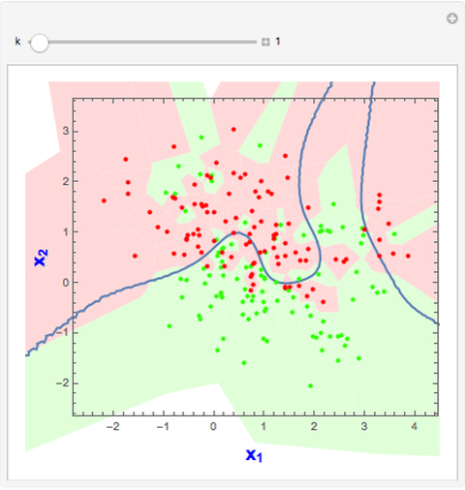
Learn ML Concepts
2.Start Learning ML with Python Course Name-Applied Machine Learning With Python Platform-Coursera Topics Covered- KNN , Overfitting and Underfitting , Linear Regression , Logistic Regression , SVM , Decision Trees , Model Evaluation , Naïve Bayes Classifier , Random Forests, Gradient Boosted Decision Trees ,Neural Networks, Data Leakage, Dimensionality Reduction and Manifold Learning, Clustering
How to Get Started with ML

Slide 4
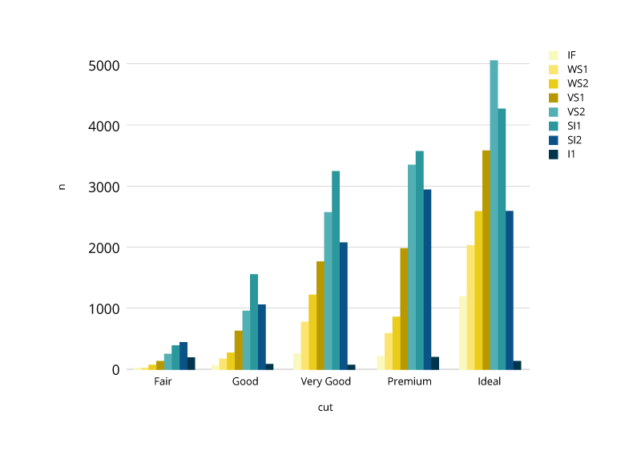
How to Get Started with ML
Learn ML Concepts
3.Start doing different types of processes like data cleaning, pre processing , data visualisation . Platform-Kaggle Courses- Data Visualisation Pandas Feature Engineering

Slide 5

How to Get Started with ML
Learn ML Concepts
4.Start Implementing various ML methods on datasets at https://www.kaggle.com/

Slide 6

How to get started with Machine Learning
Learn ML Concepts
5.Start Learning and Implementing Deep Learning on Kaggle Datasets Platform-Coursera Specialisation - Tensorflow In Practice Specialisation Introduction to Machine Learning Convolutional Neural Network in Tensorflow (Includes Computer Vision) Natural Language Processing in Tensorflow (Training a model with words) Sequence , Time Series and Prediction (Weather Prediction , Stock Price Prediction)ow: Data and Deployment Specialization

Slide 7
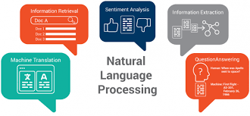
How to get started with ML
Learn ML Concepts
6.Start Learning Natural Language Processing i)Platform-Kaggle Course Name -Natural Language Processing Topics Covered- Text Classification , Word Vectors ii)Platform-Coursera Courses- Natural Language Processing Classification and Vector Spaces Probababilistic models Sequence Models Attention Models

Slide 8
How to get started with ML
Learn ML Concepts
7.Start Learning Computer Vision Platform-Kaggle Course – Computer Vision Topics Covered- CNN , ReLu , Convnets , Data Augmentation Platform-Coursera Course – Tensorflow : Advanced Techniques Specialisation Topics Covered- Object Detection , Image Segmentation , Visualization and Interpretability

Slide 9
How to get started with ML
Learn ML Concepts
8.Learn SQL Platform-Kaggle Intro-To-SQL BigQuery , Basic SQL Queries Advanced-SQL Topics Covered- Joins and Unions , Analytic Functions ,Nested and Repeated Data , Writing Efficient Queries

Slide 10
ML Book Club
1. ML Book Club is our initiative for all members of DSC who are interested in ML. 2. We constantly share some resources like books, Python notebooks for different ML-related tasks, and YouTube videos . 3. We conduct meetings on weekly basis in which we discuss/study about ML and related topics and solve doubts of our members. 4. Each ML Book Club meet ends with a fun quiz. The top performers based on the quiz scores get awarded with DSC Badges, and will be showcased on the DSC website.

Slide 11
ML Book Club
How to join the ML Book Club channel?
You can join the club using the following link- https://discord.gg/78g9XyDhr5

Slide 12
Upcoming Session at ML Talks
Event Date –Feb 14, 2021 We would be learning about two most common libraries used in ML which are NumPy and Pandas. We will also learn how to use Google Colab which is the most convenient way to practice ML.

Slide 13
Thank You

